Slide 1
Post-Ionization Modelling by
Sha (Esther) Li and Lan (Lance) Yao

Slide 2
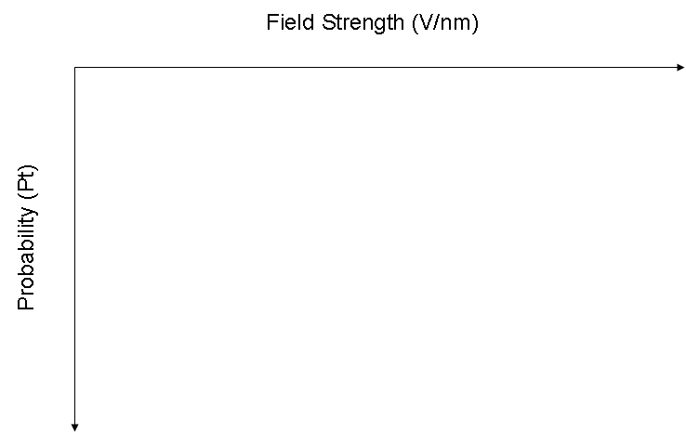
Two Axis Plot

Slide 3
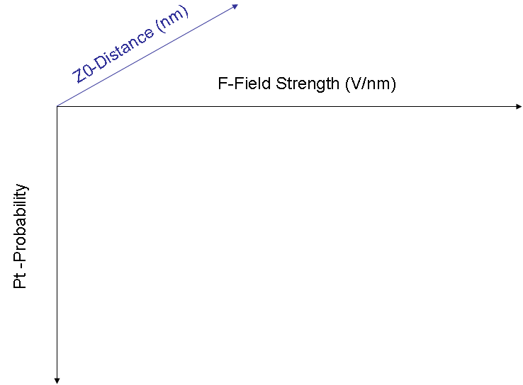
Three Axis Model

Slide 4
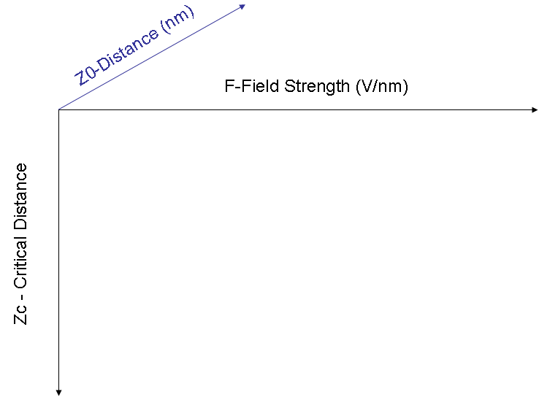

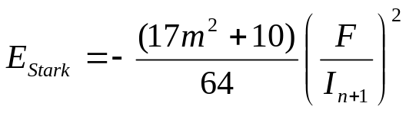
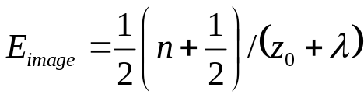
Critical Distance (Zc)
^{(2.11)}
^{(2.8)}
^{(2.9)}

Slide 5
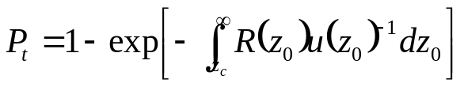
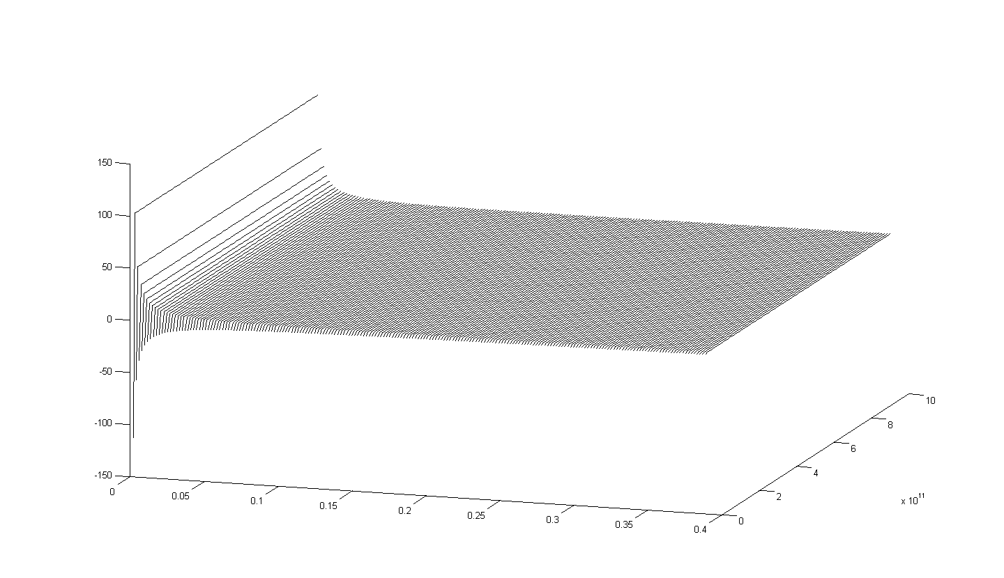
Critical Distance (Zc)
Note: Although Zc depends on both F and Z0, the main trend of Zc is mostly followed by F, whereas in Z0 direction, Zc approaches to a constance, except when Z0 is extremely small, which can be ignored (as shown). Therefore, in our model, even though we calculated Zc value based on each (F,Z0) points, we just used Zc value at some points ( the red line) with constant Z0, purely depends on F. The reason doing this is when we do integration along Z0, we have to make Zc independent from Z0.
Zc - Critical Distance (au)
Z0-Distance (au)
F-Field Strength (V/au)

Slide 6
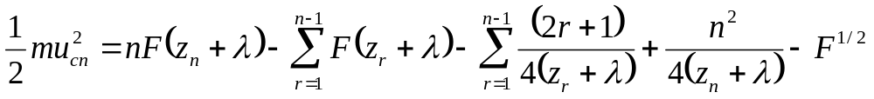
Ion Velocity (Ucn)
eq(3.36)

Slide 7
Ionization Rate Constant (Rz0)
eq(3.21)

Slide 8
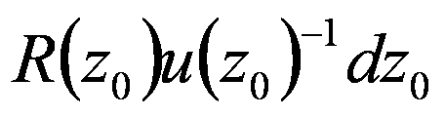
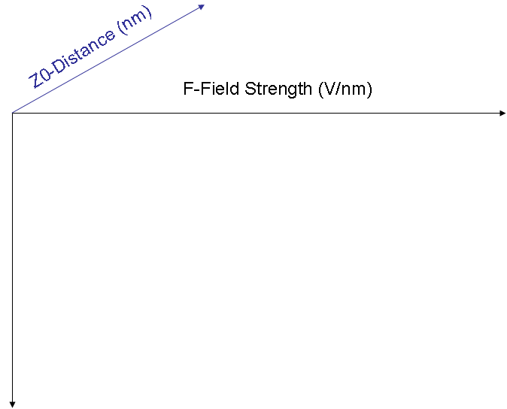
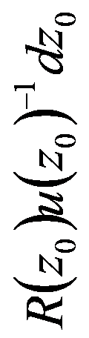
Plot
dF
Note: The actual plot must not look like this, just roughly showing R(z0) and u(z0) both are a function of Z0 at a particular F

Slide 9




Integration of
Zc3
Zc2
Zc1
F1
F3
F2
dF
Note: the integration is computing the area under the curve boundary by Zc(Zc1,Zc2,Zc3....) to infinity in z0. at a particular F(F1,F2,F3....)

Slide 10

Final plot Pt vs F
Zc3
Zc2
Zc1
F1
F3
F2
dF
Note: based on the probability formula, Pt is related the magnitude of the integration area

Slide 11
Final Plots look like this...
Pt1
Pt2
Pt3

Slide 12
If want to approch to Kingham;s result
Pt1
Pt2-Pt1
Pt3-Pt2

